Slide 1
Cryptography and Network Security Lab
Lab-1
Dr. Sunil Gupta
Professor- SoCS, UPES

Slide 2
Guide Lines
Lab work is divided into 12 weeks.
Each week has certain objectives to be accomplished.
Each week has 2 hours of Lab work.
Students can implement the specified algorithm using any programming Language(C, C++, Java cryptography).
All students are required to records their work in Project File (individual)
Continuous evaluation of Lab should be done.
Evaluation is done every week.

Slide 3
EXPERIMENT NO – 1: Shift Cipher Techniques
Objective: - To understand the concept of Shift Ciphers.
Implement a program to show the working of Additive/Caesar cipher.
Implement a program to show the working of Multiplicative cipher
Implement a program to show the working of Affine cipher
Implement a program to show the working of Vigenère cipher.
Implement a program to show the working of Playfair cipher.
Implement a program to show the working of Hill cipher.

Slide 4
EXPERIMENT NO – 2: Classical Encryption Techniques Objective: - To understand the concept of passwords, Brute Force Techniques.
Develop a program to show the workings of substitution method.
Develop a login system, which will take two inputs username and password (4 digit pin). As an Adversary develop a program, which will generate passwords serially, and find the right password for the developed login system.

Slide 5
EXPERIMENT NO-3: DES Encryption Techniques Objective: - To understand the concept of Block Ciphers
Implement the Data Encryption Standards

Slide 6
EXPERIMENT NO-4: AES Encryption Techniques Objective: - To understand the concept of Block Ciphers
Implement the Advanced Encryption Standards.
EXPERIMENT-5: Public key Cryptography: Objective: - To understand the concept of secret key, cipher and plain text.
Design a system, which will demonstrate the working of RSA public key cryptography.

Slide 7
EXPERIMENT-6: Diffie Hellman Key Exchange Algorithm: Objective: - To understand the concept of exchanging keys through Diffie Hellman.
Design a system, which will demonstrate the working of Diffie Hellman.

Slide 8
Experiment No 7: Hash Function
Objective: - To understand the concept of Integrity, Non-repudiation and message digest.
Write a program to demonstrate the working of SHA-512.
Create a mail (treat it as a string) and attach the digital signature with your mail. show that the attached digital signature can be used to:
Verify the author and the date and time of the signature.
Authenticate the contents at the time of the signature.

Slide 9
EXPERIMENT NO. 1
AIM: To implement Ceaser Cipher Encryption-Decryption.
Theory:
In cryptography, a Caesar cipher, also known as a Caesar's cipher, the shift cipher, Caesar's code or Caesar shift, is one of the simplest and most widely known encryption techniques.
It is a type of substitution cipher in which each letter in the plaintext is replaced by a letter some fixed number of positions down the alphabet.
For example, with a shift of 3, A would be replaced by D, B would become E, and so on.

Slide 10
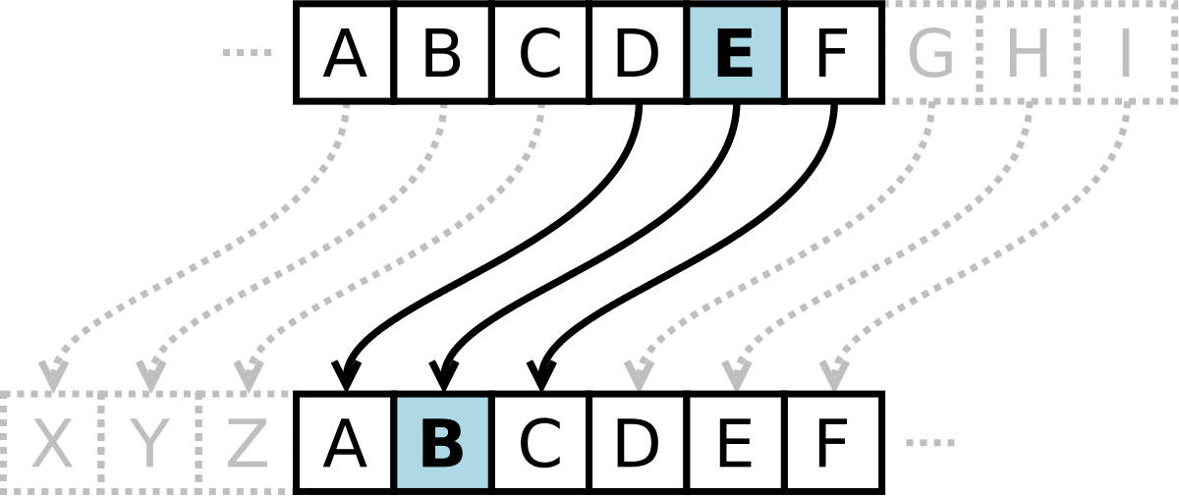

Slide 11
Example
The transformation can be represented by aligning two alphabets; the cipher alphabet is the plain alphabet rotated left or right by some number of positions. For instance, here is a Caesar cipher using a left rotation of three places (the shift parameter, here 3, is used as the key):
Plain: ABCDEFGHIJKLMNOPQRSTUVWXYZ
Cipher: DEFGHIJKLMNOPQRSTUVWXYZABC

Slide 12
Example
When encrypting, a person looks up each letter of the message in the "plain" line and writes down the corresponding letter in the "cipher" line. Deciphering is done in reverse.
Cipher text: WKH TXLFN EURZQ IRA MXPSV RYHU WKH ODCB GRJ
Plaintext: the quick brown fox jumps over the lazy dog

Slide 13
Breaking of Caesar's Cipher :
Obviously, it had two weaknesses.
The first was that the algorithm was not particularly strong.
If English text was being encrypted, then it would be relatively simple to compare the frequency of letters in the cipher text against the frequency of letters in standard English.
Statistics would soon reveal patterns that pointed out the probable plain text letter associated with each cipher text letter.
Once a single association was found the entire algorithm could be cracked.
No message would be secure.

Slide 14
Frequency analysis
Frequency analysis : Caesar's Cipher is so vulnerable to frequency analysis. It is because there is a one-to-one relationship between each letter. If a sufficiently large ciphertext is given, the plaintext can be found out by frequency analysis.
If there is a sufficiently large ciphertext, it would be solved by comparing the frequency of letters in the cipher text against the frequency of letters in standard English.
If the frequency of the letter in the cipher text is almost the same as the frequency of letters in standard English, we can find out which letter is substituted for the letter in ciphertext. Then the message would be decrypted.

Slide 15
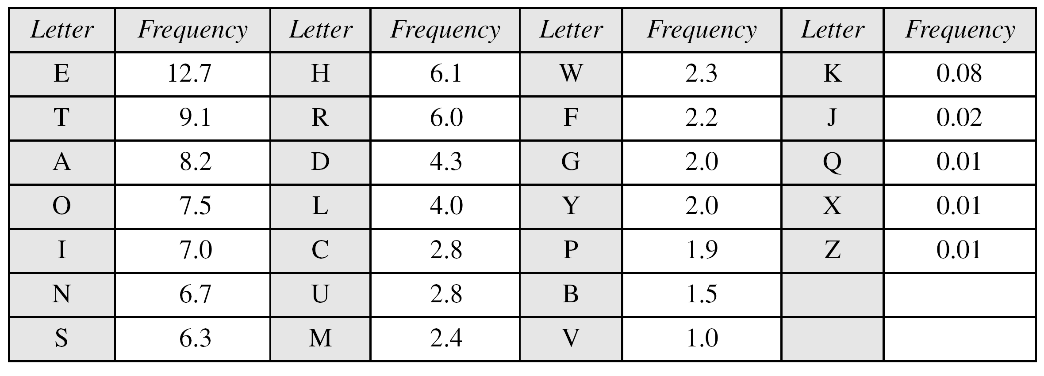

Slide 16
Vigenere Cipher
Example
We can encrypt the message “She is listening” using the 6-character keyword “PASCAL”.

Slide 17
Let us see how we can encrypt the message “She is listening” using the 6-character keyword “PASCAL”. The initial key stream is (15, 0, 18, 2, 0, 11). The key stream is the repetition of this initial key stream (as many times as needed).

